Slide 1
What’s your favorite season?

Slide 2
season is ______.
warm
cool
hot
cold

Slide 3
SENTENCE
Q:What’s your favorite season?
A:My favorite season is _____.
It’s _____ in _______.
spring
warm
spring
*favorite 最愛的…
*season 季節

Slide 4
所有格
My favorite season is _____.
主格 | 所有格
I
You
He
She
we
they
Amy
my 我的
your 你的
his 他的
her 她的
our 我們的
their 他們的
Amy’s Amy的

Slide 5
Survey-Ask and Write P.41 – 3mins./ a boy and a girl / answer*3
spring | summer | fall | winter
Our favorite season is __________.
Their favorite season is___________.

Slide 6
What can you do in spring? I can ____________in spring.
spring | summer | fall | winter
go on a picnic | go swimming | go hiking | go skiing
? | ? | ? | ?
visit a farm go to the zoo go flower viewing Blow bubbles in the park Plant some seeds ride a bike | go to beach climb a tree play hide and seek go fishing take a trip go camping watch the sunrise | Fly a kite Take a walk go shopping watch maples read in the park. | go to a hot spring eat hot pot watch TV on the sofa go jogging
What do you like to do?

Slide 7
1. spring
2. summer
3. fall
4. winter

Slide 8
1. spring
2. summer
3. fall
4. winter

Slide 9
1. spring
2. summer
3. fall
4. winter

Slide 10
1. spring
2. summer
3. fall
4. winter

Slide 11
1. spring
2. summer
3. fall
4. winter

Slide 12
1. spring
2. summer
3. fall
4. winter

Slide 13
1. spring
2. summer
3. fall
4. winter

Slide 14
1. spring
2. summer
3. fall
4. winter

Slide 15
1. spring
2. summer
3. fall
4. winter

Slide 16
1. spring
2. summer
3. fall
4. winter

Slide 17
1. spring
2. summer
3. fall
4. winter

Slide 18
1. spring
2. summer
3. fall
4. winter

Slide 19
1. spring
2. summer
3. fall
4. winter

Slide 20
1. spring
2. summer
3. fall
4. winter

Slide 21
1. spring
2. summer
3. fall
4. winter

Slide 22
1. spring
2. summer
3. fall
4. winter

Slide 23
SENTENCE
What’s your favorite season?
My favorite season is ______.
It’s _____ in _______.
spring
warm
spring
*favorite 最愛的…
*season 季節

Slide 24
所有格
My favorite season is _____.
主格 | 所有格
I
You
He
She
we
they
Amy
my 我的
your 你的
his 他的
her 她的
our 我們的
their 他們的
Amy’s Amy的

Slide 25
交換明信片Post Crossing 寄出者
Dear ____ ,
My name is ____.
I ‘m at Ali mountain with my friends. My favorite season is fall. It’s cool in fall. And I can go hiking in fall. How about you? Do you like fall, too?
Hope to hear from you soon.
_(NAME)__
2020.5.8

Slide 26
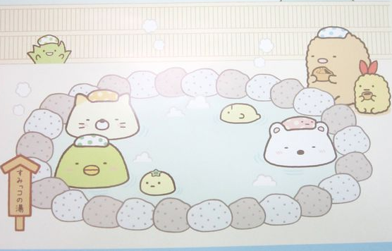
交換明信片Post Crossing 回信者
Dear ____ ,
I’m glad to get
your postcard. I like summer.
It’s sunny and hot in summer.
I like swimming in summer.
But my favorite season is winter. It’s cold in winter. And I can go to a hot spring in winter.
_NAME_
2020.5.9

Slide 27
Listen, look and Write the correct word.

